Slide 1
6TH SEMESTER - COMPUTER GRAPHICS AND VISUALIZATION (18CS62) MODULE-1 OVERVIEW OF COMPUTER GRAPHICS AND OPENGL
VARALAKSHMI B D
Assistant professor
DEPARTMENT OF COMPUTER SCIENCE AND ENGINEERING
ACHARYA INSTITUTE OF TECHNOLOGY

Slide 2
TEXT BOOK
1. Donald Hearn & Pauline Baker: Computer Graphics with OpenGL Version,3rd/4thEdition, Pearson Education,2011
2. Edward Angel: Interactive Computer Graphics- A Top Down approach with OpenGL, 5th edition. Pearson Education, 2008
Reference Book
3. James D Foley, Andries Van Dam, Steven K Feiner, John F Huges Computer graphics
with OpenGL: pearson education

Slide 3
Module-1 Overview
In this Module we discuss about :
Basics of computer graphics
Application
Display Devices: Random Scan and Raster Scan displays,
Graphics software- OpenGL
Introduction to OpenGL ,
Coordinate reference frames,
OpenGL functions,
Line drawing algorithms(DDA, Bresenham’s),
Circle generation algorithms (Bresenham’s).

Slide 4
Basics of Computer Graphics
What is computer graphics?
Is an art of drawing pictures, lines, charts etc on computer screen with the help of programming language.
Computer graphics is a process of generating, manipulating, storing and displaying graphics object.
Ex: Such as pictures, charts, graphs, diagrams.
In computer graphics objects are presented as a collection of discrete picture elements.
Picture Element = Pixel
The pixel is the smallest screen elements.

Slide 5
Basics of Computer Graphics
Advantages of computer graphics :
High quality graphics displays on PC
It provides tools for producing pictures
Produce animation using static image with computer graphics
Produce 2-D or 3-D using different simulators.
Using motion dynamics tool, user can make object stationary and the viewer moving around them.
Using update dynamics, it is possible to change the shape, colour or other properties of object.

Slide 6
Applications of Computer Graphics
Graphs and Charts.
Entertainment
Computer Aided Design
Virtual reality environment.
Education and Training
Computer Animation
Data Visualization
Image processing
Graphical user interface

Slide 7
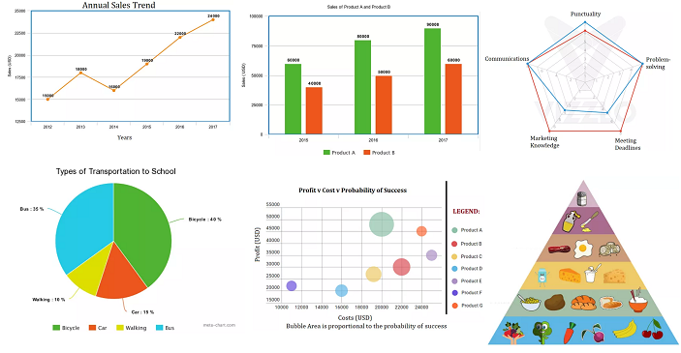
1. Graphs and Charts
This application is normally used to summarize financial, statistical, mathematical, scientific, and economics data for research.
Graphs and charts can be in 3-D formats to make the presentation.

Slide 8
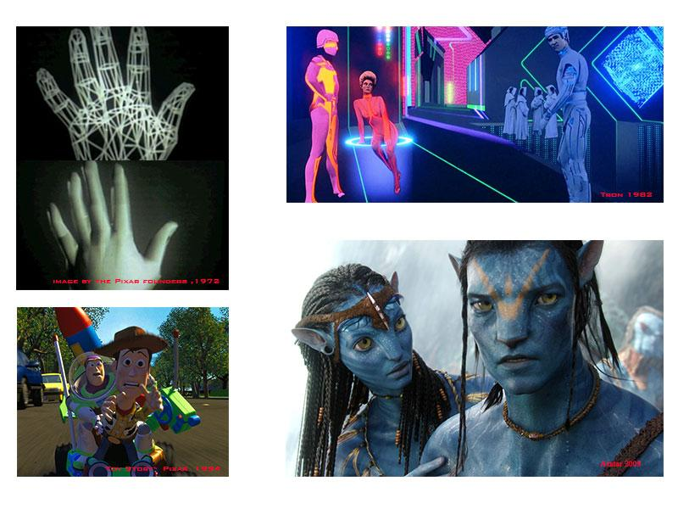
2. Entertainment

Slide 9
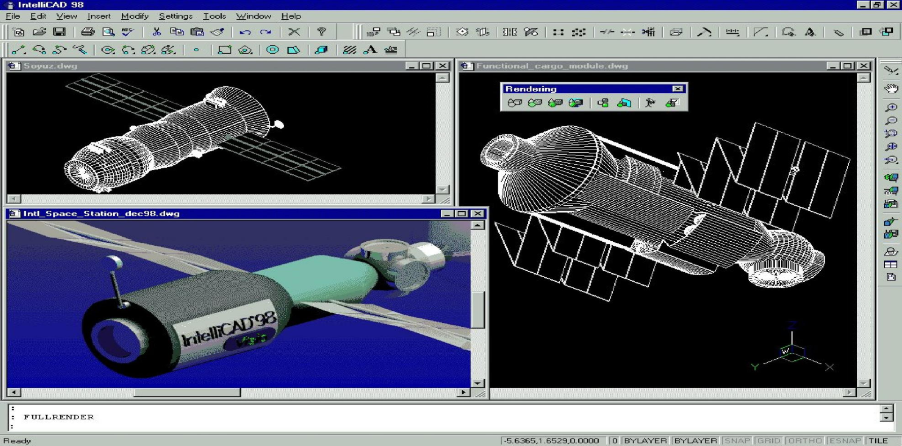
3. Computer Aided Design
Use of computer graphics is in design process of engineering and architecture system.
CAD applications are design to create building, automobiles, aircraft, spacecraft, textiles and more models

Slide 10
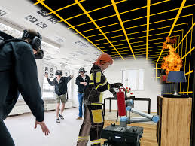


4. Virtual reality environment.
Virtual Reality (VR) is the use of computer technology to create a simulated environment.

Slide 11
5. Education and Training
A wide range of individual education software with multimedia.
It is also used in classroom to enhance the educational experience and simplify teacher’s work.
In distance learning, where all students may not be at same place during a class.

Slide 12

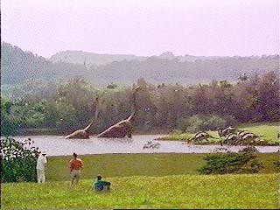
6. Computer Animation

Slide 13

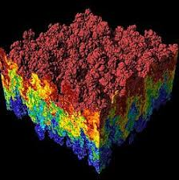
7. Data Visualization
Visualization is any technique for creating images, diagrams, or animations to communicate a message. Visualization through visual imagery has been an effective way to communicate both abstract and concrete ideas since the dawn of humanity.

Slide 14
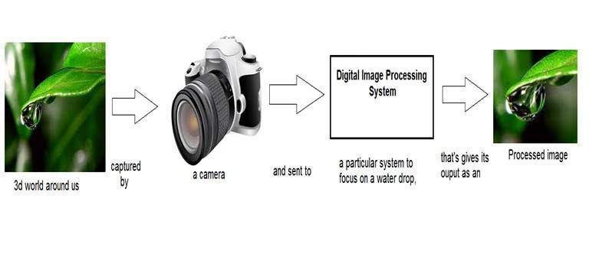
8.Image processing
Image processing, converts an existing image into digitized form by converting the image file format.
Image processing technique is mostly used in commercial application that can rearrange/modify image in different format.

Slide 15

9. Graphical user interface
A GUI (graphical user interface) is a system of interactive visual components for computer software. A GUI displays objects that convey information, and represent actions that can be taken by the user.
Major component of GUI interface is a window manager that allows a user to display multimedia window areas.
Interface generally comes with a menu and icons for fast selection of processing options.

Slide 16
Video Display Devices
Display devices also known as output devices.
The most commonly used output devices in a graphics system is a video monitor.

Slide 17
Video Display Devices
Type of display devices:
Cathode-Ray Tubes(CRT)
Raster Scan
Random Scan

Slide 18
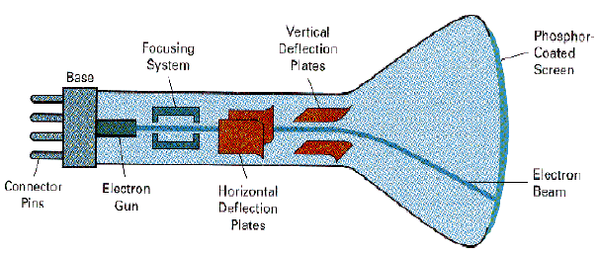
CATHODE RAY TUBE(CRT)
Video Display Devices
The operation of most video monitors is based on the standard cathode-ray tube (CRT) design.

Slide 19
CRT
Video Display Devices
A CRT is an evacuated glass tube.
An electron gun at the rear of the tube produces a beam of electron which is directed towards the front of the tube (screen) by a high voltage.
The inner side of the screen is coated with phosphor substance which gives off light when it is stroked by electron.

Slide 20
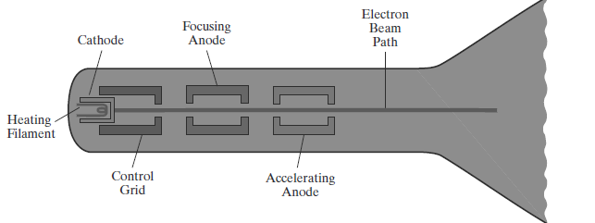
CRT
Video Display Devices
CRT
The control grid voltage determines
the velocity achieved by the electrons before they hit the phosphor.
how many electrons are actually in the electron beam.
Thus, control grid controls the intensity of spot where the electron beam is strike the screen.
The focusing system concentrates the electron beam so that the beam converges to a small point when it hits the phosphor coating.

Slide 21
CRT
Video Display Devices
CRT
The deflection system of the CRT consists of two pairs of parallel plates, referred to as the vertical and horizontal deflection plates.
The voltage applied to vertical deflection of the electron beam and voltage applied to the horizontal deflection plates controls the horizontal deflection of the electron beam.
There are two techniques used for producing images on the CRT screen : Random Scan (Vector scan) and Raster Scan.

Slide 22
Raster Scan
Video Display Devices
The most common type of graphics monitor employing a CRT is the raster-scan display, based on television technology.
In a raster-scan system, the electron beam is swept across the screen, one row at a time, from top to bottom.
Each row is referred to as a scan line.

Slide 23
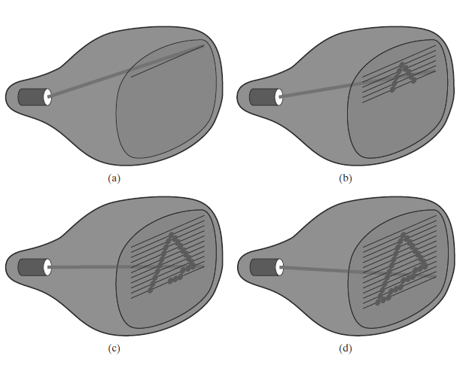
Raster Scan
Video Display Devices
As the electron beam moves across a scan line, the beam intensity is turned on and off to create a pattern of illuminated spots.
Frame refers to the total screen area.

Slide 24
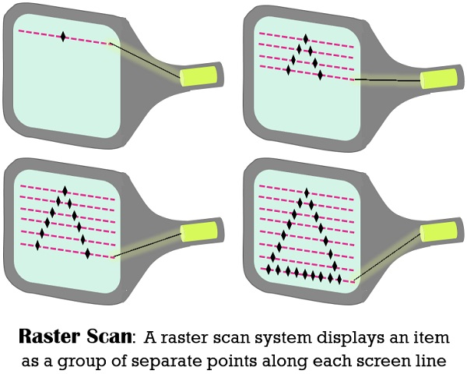
Raster Scan
Picture definition is stored in a memory area called the refresh buffer or frame buffer
This memory area holds the set of color values for the screen points.
These stored color values are then retrieved from the refresh buffer and used to control the intensity of the electron beam as it moves from spot to spot across the screen.

Slide 25
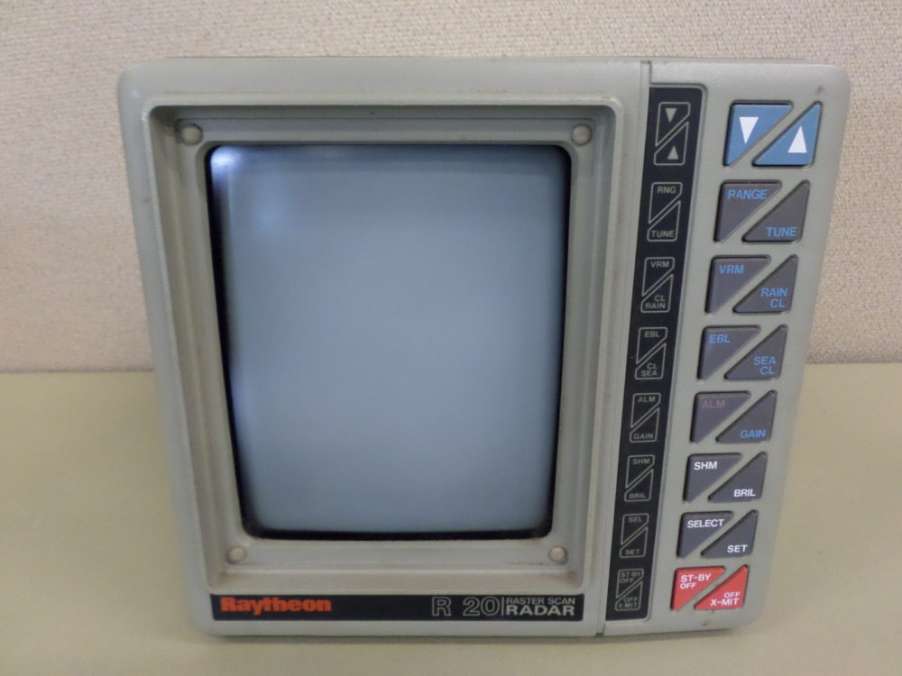
Raster Scan
Video Display Devices
Example
Home Television
Printers

Slide 26
Raster Scan
Video Display Devices
Terminologies:
Resolution
Resolution refers to the number of pixels in an image. Resolution is sometimes identified by the width and height of the image as well as the total number of pixels in the image.
Aspect ratio
The number of pixel columns divided by the number of scan lines that can be displayed by the system.
A frame buffer with one bit per pixel is commonly called a bitmap

Slide 27
Random Scan
Video Display Devices
A CRT has the electron beam directed only to those parts of the screen where a picture is to be displayed.
Pictures are generated as line drawings, with the electron beam tracing out the component lines one after the other.
Random-scan monitors are also referred to as vector displays (or stroke-writing displays or Calligraphic displays).

Slide 28
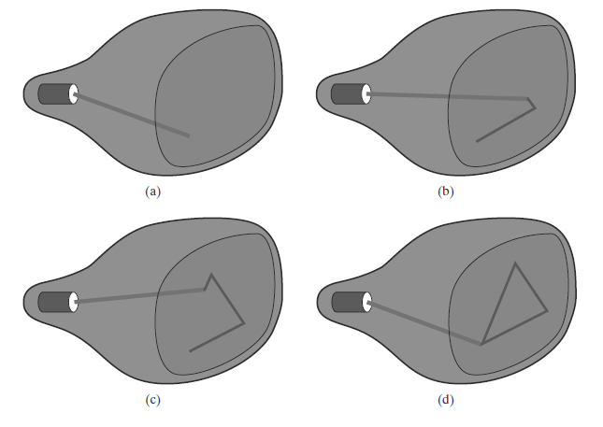
Random Scan
Video Display Devices
The component lines of a picture can be drawn and refreshed by a random-scan system in any specified order

Slide 29
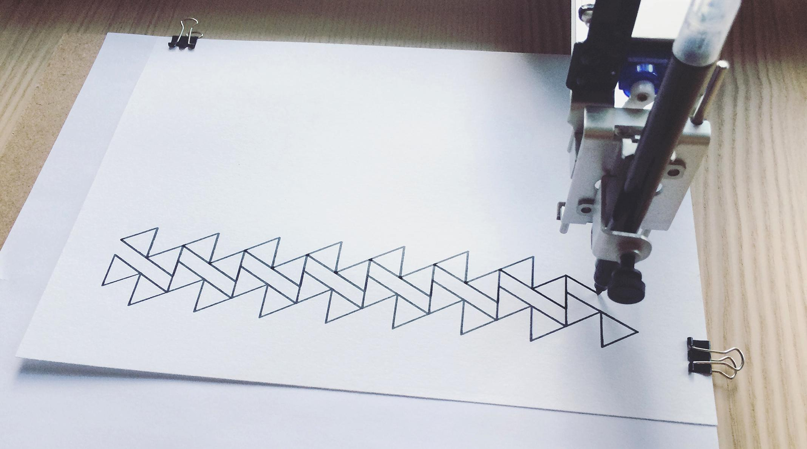
Random Scan
Video Display Devices
A pen plotter operates is an example of a random-scan, hard-copy device.

Slide 30
OpenGL
Introduction To Opengl
Coordinate Reference Frames
Specifying Two-dimensional World Coordinate Reference Frames In Opengl
Opengl Point Functions
Opengl Line Functions
Point Attributes
Line Attributes
Curve Attributes
Opengl Point Attribute Functions
Opengl Line Attribute Functions
Line Drawing Algorithms(dda, Bresenham’s)
Circle Generation Algorithms(bresenham’s)

Slide 31
Introduction to Open GL
OpenGL is a Graphics rendering API which is operating system independent, window system independent and has high-quality color images composed of geometric and image primitives.
OpenGL APIs can use following …
Gl
Glu -OpenGL Utility
Glut – GLUT (OpenGL Utility Toolkit)

Slide 32
OpenGL, GLU and GLUT
OpenGL: basic functions
GLU: OpenGL Utility library:
GLUT: OpenGL Utility Toolkit library
GLU and GLUT:
Handy functions for viewing and geometry
H&B 3-5:64-72

Slide 33
OPENGL Basic Library
A basic library of functions is provided in OpenGL for specifying graphics primitives, attributes, geometric transformations, viewing transformations, and many other operations.
Basic OpenGL Syntax
Function names in the OpenGL basic library (also called the OpenGL core library) are prefixed with gl
Each component word within a function name has its first letter capitalized.
The following examples illustrate this naming convention:
glBegin,
glClear,
glCopyPixels,
glPolygonMode.

Slide 34
OPENGL Basic Library
Certain functions require that one (or more) of their arguments be assigned a symbolic constant specifying, for instance, a parameter name, a value for a parameter, or a particular mode.
All such constants begin with the uppercase
letters GL.

Slide 35
OPENGL Basic Library
component words within a constant name are written in capital letters, and the underscore ( ) is used as a separator between all component words in the name.
The following are a few examples of the several hundred symbolic constants available for use with OpenGL functions:
GL_2D,
GL_RGB,
GL_POLYGON,
GL_AMBIENT_AND_DIFFUSE

Slide 36
OPENGL Basic Library
The OpenGL functions also expect specific data types.
To indicate a specific data type, OpenGL uses special built-in, data-type names, such as
GLbyte,
GLshort,
GLint,
GLfloat,
GLdouble,
Glboolean.

Slide 37
OpenGL syntax
Functions:
glFunction: glBegin, glClear, glVertex, …
Constants:
GL_CONSTANT: GL_2D, GL_LINE
Datatypes:
GLtype: GLbyte, GLint, GLfloat
H&B 3-5:64-72

Slide 38
OPEN GLU
The OpenGL Utility (GLU) provides routines for
setting up viewing and projection matrices, describing complex objects with line and polygon
approximations, Displaying quadrics and B-splines using linear Approximations processing the surface-rendering operations, and Other complex tasks.
GLU function names start with the prefix glu.
gluOrtho2D(0, 200, 0, 150)

Slide 39
OPENGLUT
The OpenGL Utility Toolkit(GLUT)
Provides a library of functions for interacting with any screen-windowing system. contains methods for describing and rendering quadric curves and surfaces.
The GLUT library functions are prefixed with glut.
Information about the latest version of GLUT and download procedures for the source code are available at the following web site:
http://www.opengl.org/resources/libraries/glut/

Slide 40
Header Files
In all of our graphics programs, we will need to include the header file for the OpenGL core library.
OpenGL and GLU header files contains macros needed by the Microsoft Windows version of the OpenGL libraries.
So the source file in this case would begin with
#include <windows.h>
#include <GL/gl.h>
#include <GL/glu.h>

Slide 41
Display-Window Management Using GLUT
Perform the GLUT initialization with the statement
glutInit (&argc, argv);
Display window is to be created on the screen with a given caption for the title bar.
glutCreateWindow ("An Example OpenGL Program");

Slide 42
To specify what the display window is to contain.
For this, we create a picture using OpenGL functions and pass the picture definition to the GLUT routine glutDisplayFunc, which assigns our picture to the display window.
Then the following function call passes the line-segment description to the display window:
glutDisplayFunc (lineSegment);

Slide 43
But the display window is not yet on the screen.
We need one more GLUT function to complete the window-processing operations.
GlutMainLoop ( );
It displays the initial graphics and puts the program into an infinite loop that checks for input from devices such as a mouse or keyboard.

Slide 44
glutInitWindowSize function is used to set the initial pixel width and height of the display window.
Specify a display window with an initial width of 400 pixels and a height of 300 pixels with the statement
glutInitWindowSize (400, 300);

Slide 45
For Display window,we can set buffering and a choice of color modes, with the glutInitDisplayMode function.
Arguments for this routine are assigned symbolic GLUT constants.
For example, the following command specifies that a single refresh buffer is to be used for the display window and that we want to use the color mode which uses red,green, and blue (RGB) components to select color values:
glutInitDisplayMode (GLUT_SINGLE |GLUT_RGB);

Slide 46
For Display window,we can set buffering and a choice of color modes, with the glutInitDisplayMode function.
Arguments for this routine are assigned symbolic GLUT constants.
For example, the following command specifies that a single refresh buffer is to be used for the display window and that we want to use the color mode which uses red,green, and blue (RGB) components to select color values:
glutInitDisplayMode (GLUT_SINGLE | GLUT_RGB);

Slide 47
The first three arguments in this function set the red, green, and blue component colors to the value 1.0, giving us a white background color for the display window.
If, instead of 1.0, we set each of the component colors to 0.0, we would get a black background.
The fourth parameter in the glClearColor function is called the alpha value for the specified color.
One use for the alpha value is as a “blending” parameter.
alpha values can be used to determine the resulting color for two overlapping objects.

Slide 48
Although the glClearColor command assigns a color to the display window, it does not put the display window on the screen.
To get the assigned window color displayed, we need to invoke the following OpenGL function:
glClear (GL_COLOR_BUFFER_BIT);
The argument GL COLOR BUFFER BIT is an OpenGL symbolic constant specifying that it is the bit values in the color buffer (refresh buffer) that are to be set to the values indicated in the glClearColor function.

Slide 49
Example
glClearColor(1.0,1.0,1.0,0.0);// Background color
glMatrixMode(GL_PROJECTION); // Set transformation
glLoadIdentity;
gluOrtho2D(0, 200, 0, 150);
glClear(GL_COLOR_BUFFER_BIT); // Clear background
glColor3f(1.0, 0.0, 0.0); // Set color to red
glBegin(GL_LINES); // Draw line
glVertex2i(180, 15); // - first point
glVertex2i(10, 145); // - second point
glEnd; // Ready with line
glFlush; // Send
H&B 3-5:64-72

Slide 50
Example

Slide 51
GLUT Callback functions
Event-driven: Programs that use windows
Input/Output
Wait until an event happens and then execute some pre-defined functions according to the user’s input
Events – key press, mouse button press and release, window resize, etc.
Your OpenGL program will be in infinite loop

Slide 52
GLUT Callback Functions
Callback function : Routine to call when an event happens
Window resize or redraw
User input (mouse, keyboard)
Animation (render many frames)
“Register” callbacks with GLUT
glutDisplayFunc( my_display_func );
glutIdleFunc( my_idle_func );
glutKeyboardFunc( my_key_events_func );
glutMouseFunc ( my_mouse_events_func );

Slide 53
Event Queue
Keyboard
Event queue
….
MainLoop()
Mouse
Window
Mouse_callback()
{
….
{
Keypress_callback()
{
….
{
window_callback()
{
….
{

Slide 54
Coordinate Reference Frames
To describe a picture - Cartesian coordinate system, called the world-coordinate reference frame, which could be either two dimensional or three-dimensional.
To describe the objects in our picture - give geometric specifications in terms of positions in world coordinates.

Slide 55
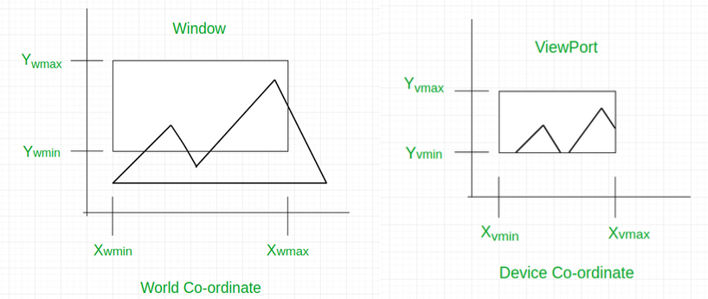

Slide 56
Coordinate Reference Frames
Screen Coordinates
Locations on a video monitor are referenced in integer screen coordinates, which correspond to the pixel positions in the frame buffer.
Pixel coordinate values give the scan line number (the y value) and the column number (the x value along a scan line).

Slide 57
Coordinate Reference Frames
Screen Coordinates
Hardware processes will address pixel positions with respect to the top-left corner of the screen.
Scan lines are then referenced from 0, at the top of the screen, to some integer value, ymax, at the bottom of the screen, and pixel positions along each scan line are numbered from 0 to xmax, left to right.

Slide 58
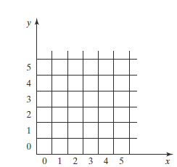
Coordinate Reference Frames
Software commands, we can set up any convenient reference frame for screen positions.
For example, we could specify an integer range for screen positions with the coordinate origin at the lower-left of a screen area or we could use non integer Cartesian values for a picture description.

Slide 59
Coordinate Reference Frames
Once pixel positions have been identified for an object, the appropriate color values must be stored in the frame buffer.
Low-level procedure of the form
setPixel (x, y);
getPixel (x, y, color);

Slide 60
Specifying A Two-Dimensional World-Coordinate Reference Frame in OpenGL
The gluOrtho2D command is a function we can use to set up any two dimensional Cartesian reference frame.
gluOrtho2D function specifies an orthogonal projection,
Assign the identity matrix as the projection matrix before defining the world-coordinate range.

Slide 61
Specifying A Two-Dimensional World-Coordinate Reference Frame in OpenGL
Two-dimensional object -define the coordinate frame for the screen display window with the following statements:
glMatrixMode (GL_PROJECTION);
glLoadIdentity ( );
gluOrtho2D (xmin, xmax, ymin, ymax);

Slide 62
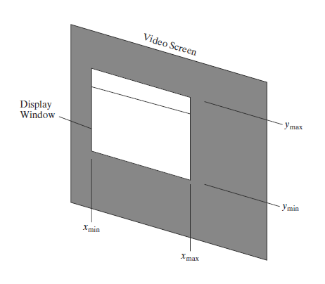
Specifying A Two-Dimensional World-Coordinate Reference Frame in OpenGL
The display window will then be referenced by coordinates (xmin, ymin) at the lower-left corner and by coordinates (xmax, ymax) at the upper-right corner

Slide 63
OpenGL Point Functions
OpenGL function to state the coordinate values for a single position:
glVertex* ( );
Calls to glVertex functions must be placed between a glBegin function and a glEnd function.

Slide 64
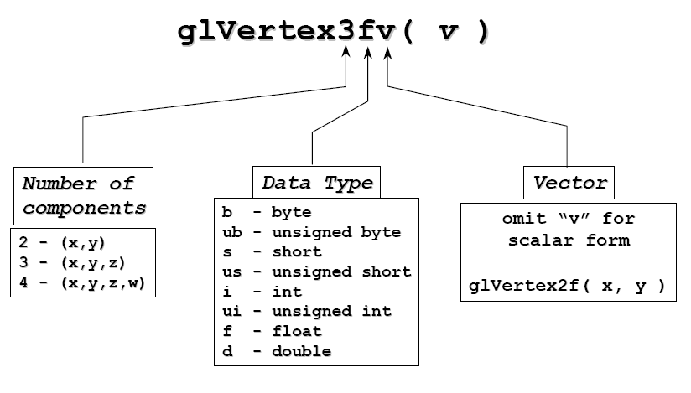
OpenGL Command Format
glVertex3fv

Slide 65
OpenGL Point Functions
OpenGL function to state the coordinate values for a single position:
glVertex* ( );
Calls to glVertex functions must be placed between a glBegin function and a glEnd function.

Slide 66
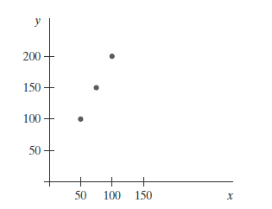
OpenGL Point Functions
glBegin (GL_POINTS);
glVertex2i (50, 100);
glVertex2i (75, 150);
glVertex2i (100, 200);
glEnd ( );

Slide 67
OpenGL Point Functions
Alternatively, we could specify the coordinate values for the preceding points in arrays such as
int point1 [ ] = {50, 100};
int point2 [ ] = {75, 150};
int point3 [ ] = {100, 200};
and call the OpenGL functions for plotting the three points as
glBegin (GL_POINTS);
glVertex2iv (point1);
glVertex2iv (point2);
glVertex2iv (point3);
glEnd ( );

Slide 68
OpenGL Point Functions
specifying two point positions in a three dimensional world reference frame.
Give the coordinates as explicit floating-point values:
glBegin (GL_POINTS);
glVertex3f (-78.05, 909.72, 14.60);
glVertex3f (261.91, -5200.67, 188.33);
glEnd ( );

Slide 69
OpenGL Line Functions
Provide a function for specifying one or more straight-line segments, where each line segment is defined by two endpoint coordinate positions.

Slide 70
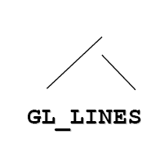
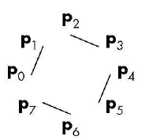
OpenGL Line Functions
Lines, GL_LINES
Pairs of vertices interpreted as individual line segments
Can specify line width using:
glLineWidth (float width)

Slide 71
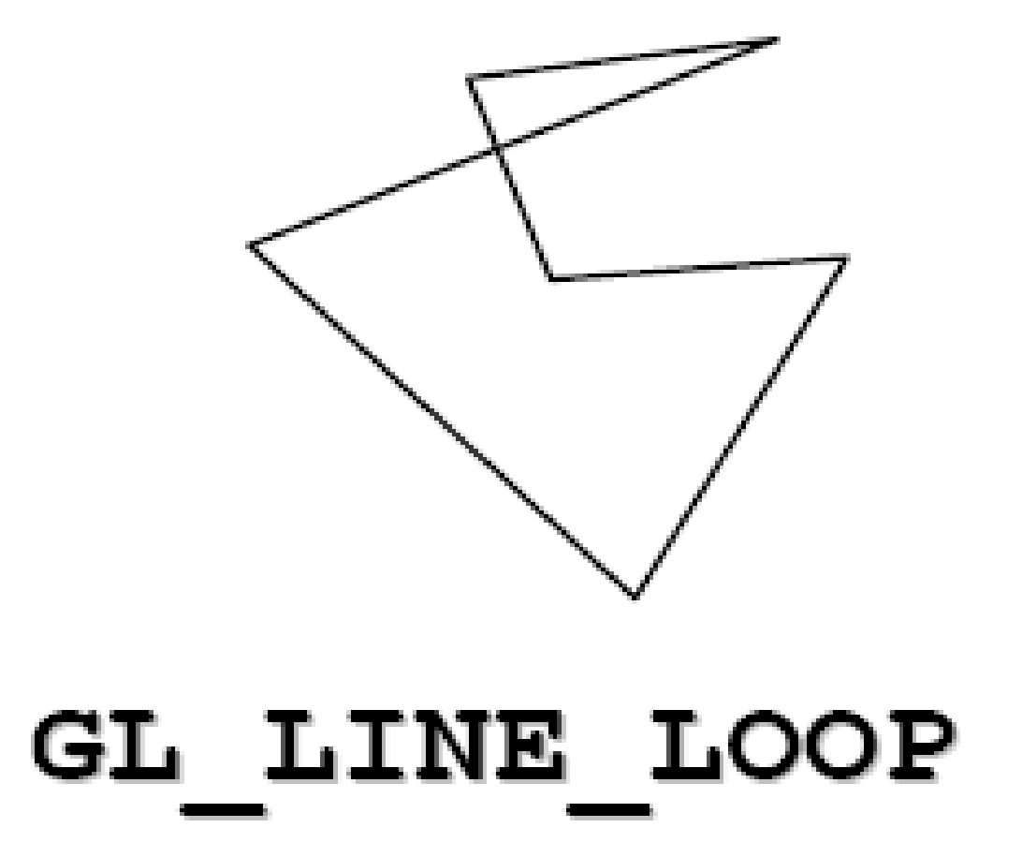
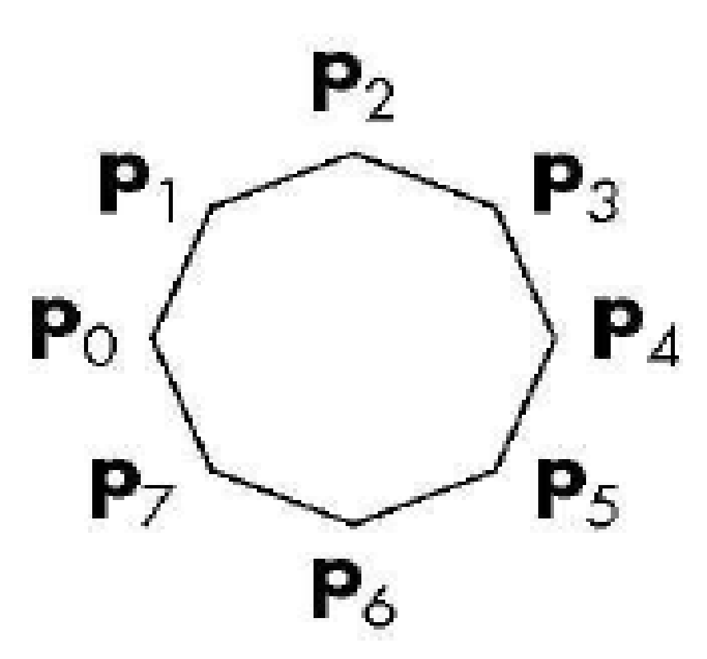
OpenGL Line Functions
Line Loop, GL_LINE_LOOP
Line strip with a segment added between last and first vertices

Slide 72
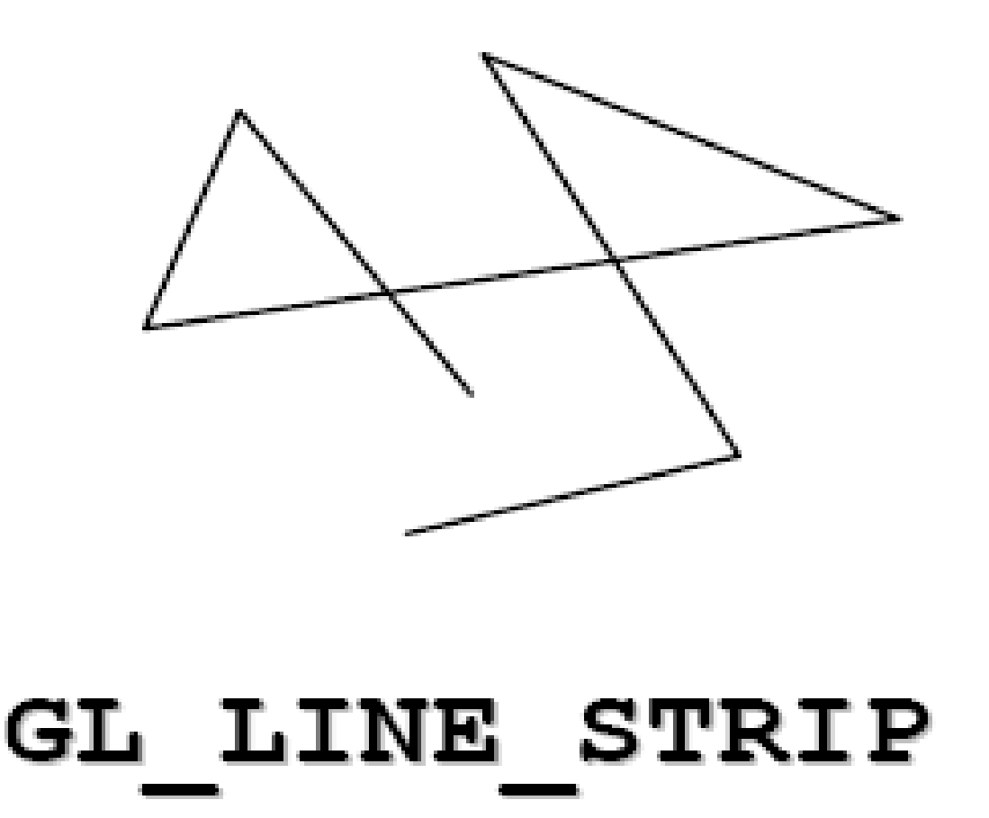
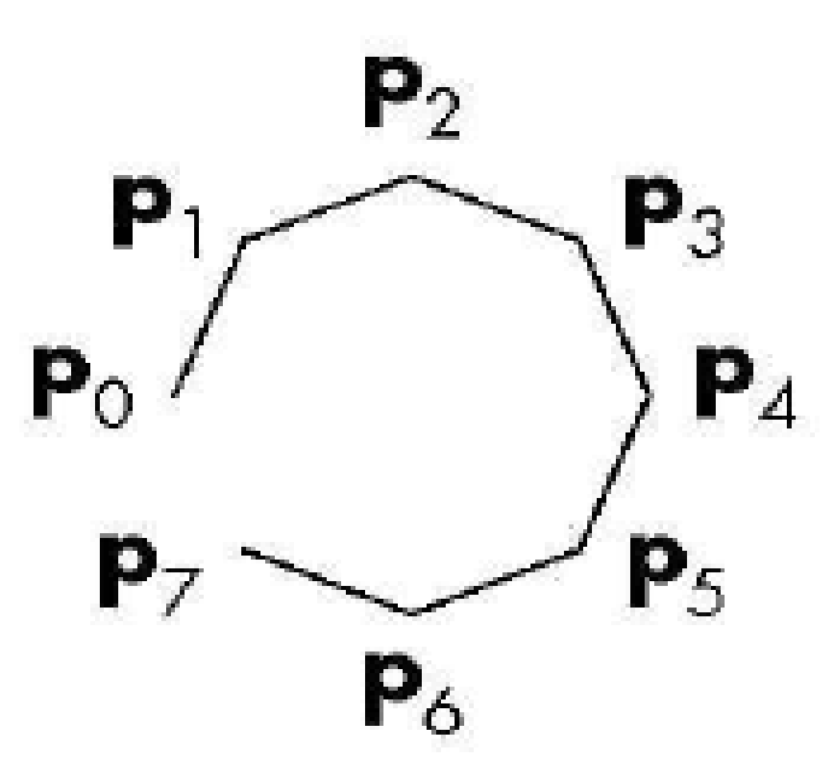
OpenGL Line Functions
Line Strip, GL_LINE_STRIP
series of connected line segments

Slide 73
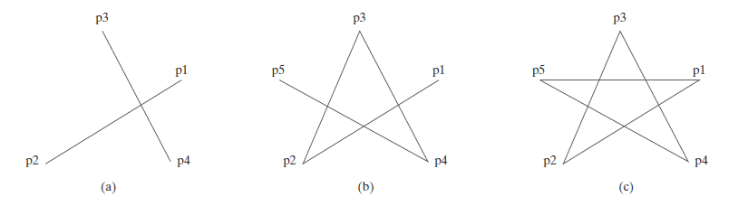
OpenGL Line Functions

Slide 74
OpenGL Curve Functions
Routines for generating basic curves, such as circles and ellipses, are not included as primitive functions in the OpenGL core library.
OpenGL Utility (GLU) library has routines for three-dimensional quadrics, such as spheres and cylinders,

Slide 75
OpenGL Curve Functions
A Second alternative to display a simple curve is to approximate it using a polyline.
We just need to locate a set of points along the curve path and connect the points with straight-line segments.
The more line sections we include in the polyline, the smoother the appearance of the curve.

Slide 76
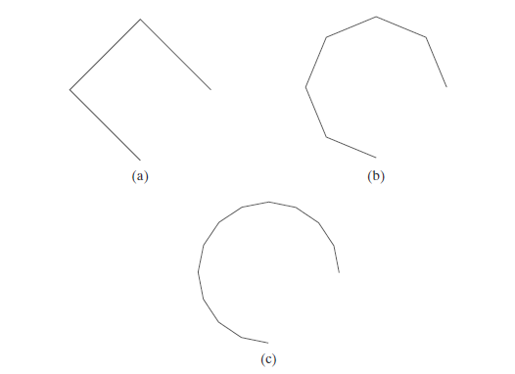
OpenGL Curve Functions

Slide 77
OpenGL Curve Functions
A third alternative is to write our own curve-generation functions based on the algorithms presented in following chapters.

Slide 78
Point Attributes
Two attributes for points:
Color
size.
Color
The displayed color of a designated point position is controlled by the current color values in the state list. Also, a color is specified with either the
glColor function or
glIndex function.

Slide 79
Point Attributes
Size
We set the size for an OpenGL point with
glPointSize (size);
Point is then displayed as a square block of pixels. The default value for point size is 1.0.
Parameter size is assigned a positive floating-point value, which is rounded to an integer .
The number of horizontal and vertical pixels in the display of the point is determined by parameter size.
Thus, a point size of 1.0 displays a single pixel,
point size of 2.0 displays a 2×2 pixel array.

Slide 80
Point Attributes
Size
glColor3f (1.0, 0.0, 0.0);
glBegin (GL_POINTS);
glVertex2i (50, 100);
glPointSize (2.0);
glColor3f (0.0, 1.0, 0.0);
glVertex2i (75, 150);
glPointSize (3.0);
glColor3f (0.0, 0.0, 1.0);
glVertex2i (100, 200);
glEnd ( );

Slide 81
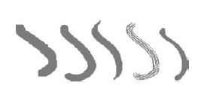
Curve Attributes
Curves
colors,
widths,
dot-dash patterns,
pen or brush options.

Slide 82
Curve Attributes
Curves can be drawn in several ways in OpenGL.
Simplest approach is to approximate the shape of the curve using short line segments.
Alternatively, curved segments can be drawn using splines.
These can be drawn using OpenGL evaluator functions, or by using functions from the OpenGL Utility (GLU) library which draw splines.

Slide 83
Line Attributes
A straight-line segment can be displayed with three basic attributes:
color
width
style.

Slide 84
Line Attributes
Line Width
glLineWidth( width);

Slide 85
Line Attributes
Line Style
Possible selections for the line-style attribute include
solid lines,
dashed lines,
dotted lines.

Slide 86
OpenGL Line-Attribute Functions
OpenGL Line-Style Function
By default, a straight-line segment is displayed as a solid line.
However, we can also display dashed lines, dotted lines, or a line with a combination of dashes and dots, and we can vary the length of the dashes and the spacing between dashes or dots.
We set a current display style for lines with the OpenGL function

Slide 87
OpenGL Line-Attribute Functions
glLineStipple (repeatFactor, pattern);
Pattern - to reference a 16-bit integer that describes how the line should be displayed.
1 bit in the pattern denotes an “on” pixel position,
0 bit indicates an “off” pixel position.
The default pattern is 0xFFFF (each bit position has a value of 1), which produces a solid line.

Slide 88
OpenGL Line-Attribute Functions
glLineStipple (repeatFactor, pattern);
repeatFactor -specifies how many times each bit in the pattern is to be repeated before the next bit in the pattern is applied.
The default repeat value is 1.
glLineStipple (1, 0x00FF);

Slide 89
We must activate the line-style feature of OpenGL.
glEnable (GL_LINE_STIPPLE);
glLineStipple (1, 0x00FF);
glDisable (GL_LINE_STIPPLE);

Slide 90
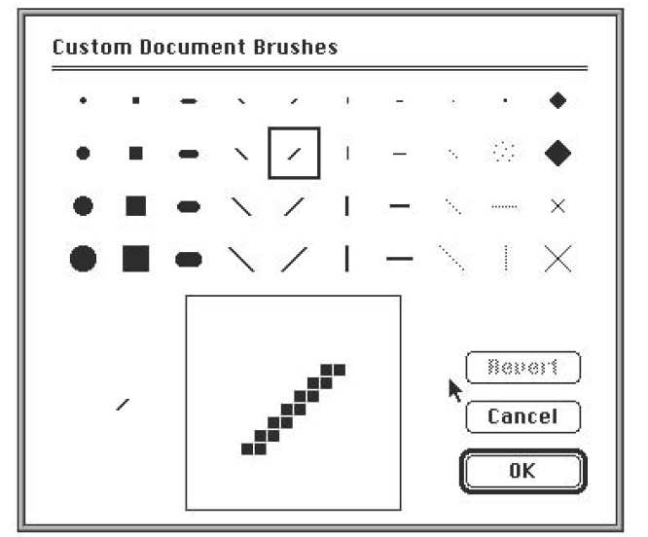
Line Attributes
Pen and Brush Options
With some packages, particularly painting and drawing systems, we can select different pen and brush styles directly.

Slide 91
Other OpenGL Line Effects
glShadeModel (GL_SMOOTH);
glBegin (GL_LINES);
glColor3f (0.0, 0.0, 1.0);
glVertex2i (50, 50);
glColor3f (1.0, 0.0, 0.0);
glVertex2i (250, 250);
glEnd ( );
glShadeModel(GL_FLAT)

Slide 92
Line drawing
What is a line?
Is the path between two end points.
Any point (x, y) on the line must follow the line equation:
y = m * x + b, where
m is the slope of the line.
b is a constant that represent the intercept on y-axis.

Slide 93
Line drawing (cont.)
If we have two end points, (x0, y0) and (x1, y1), then the slope of the line between those points can be calculated as:
m = Δy / Δx = (y1 – y0) / (x1 – x0)
To draw a line, we can use two algorithms:
DDA (Digital Differential Analyzer).
Bresenham’s Line Algorithm.

Slide 94
Line drawing – DDA algorithm
(DDA) is a scan-conversion line algorithm based on calculating either Δy or Δx.
Δy = m * Δx
Δx = Δy / m
we have many cases based on sign of the slope, value of the slope, and the direction of drawing.
Slope sign: positive or negative.
Slope value: <= 1 or >1.
Direction: (left – right) or (right – left)

Slide 95
DDA – case 1
Positive slope and left to right:
If slope <= 1 then:
x_{k+1} = x_{k} + 1
y_{k+1} = y_{k} + m
If slope > 1 then:
x_{k+1} = x_{k} + 1/m
y_{k+1} = y_{k} + 1

Slide 96
DDA – case 2
Positive slope and right to left:
If slope <= 1 then:
x_{k+1} = x_{k} – 1
y_{k+1} = y_{k} – m
If slope > 1 then:
x_{k+1} = x_{k} – 1/m
y_{k+1} = y_{k} – 1

Slide 97
DDA – case 3
Negative slope and left to right:
If |m | <= 1 then:
x_{k+1} = x_{k} + 1
y_{k+1} = y_{k} – m
If |m | > 1 then:
x_{k+1} = x_{k} + 1/m
y_{k+1} = y_{k} – 1

Slide 98
DDA – case 4
Negative slope and right to left:
If |m | <= 1 then:
x_{k+1} = x_{k} – 1
y_{k+1} = y_{k} + m
If |m | > 1 then:
x_{k+1} = x_{k} – 1/m
y_{k+1} = y_{k} + 1

Slide 99
Bresenham’s Line Algorithm
Is an efficient algorithm for line drawing.
When we have a point (x_{k}, y_{k}), then we must decide whether to draw the point (x_{k}+1, y_{k}) or (x_{k}+1, y_{k}+1).
Note that, at all cases, we move to x_{k}+1, still we must decide to move to y_{k} or y_{k}+1.
yk+1
d2
y
d1
yk
X_{k}+1

Slide 100
Bresenham’s Line Algorithm (cont.)
After calculating d1 and d2 we will choose y_{k} or y_{k}+1.
y = m (x_{k} + 1) + b
d1 = y – y_{k} = m (x_{k} + 1) + b - y_{k}
d2 = (y_{k}+1) – y = y_{k}+1 - m (x_{k} + 1) - b
d1 – d2 = 2m*x_{k} + 2m – 2y_{k} + 2b -1
d1 – d2 = 2m (x_{k} + 1) – 2y_{k} + 2b -1

Slide 101
Bresenham’s Line Algorithm (cont.)
Now we will define p_{k} (decision parameter) as:
p_{k} = ∆x (d1 – d2) = 2 ∆ y * X _{k}- 2 ∆ x * y_{k} + c,
where c = 2 ∆ y + ∆ x (2b – 1) ,
k represents the k^{th} step
If p_{k} < 0 (i.e. d1 < d2) 🡪 we plot the pixel (x_{k}+1, y_{k})
Otherwise we plot the pixel (x_{k}+1, y_{k}+1)

Slide 102
Bresenham’s Line Algorithm (cont.)
to get the next p_{k} 🡪 p_{k+1}
p_{k+1} = p_{k} + 2 ∆y - 2 ∆x (y_{k+1} – y_{k})
p0 = 2 ∆ y - ∆ x

Slide 103
Bresenham’s Line Algorithm (cont.)
Input two end points and store (x0, y0) in the frame buffer.
plot (x0, y0) to be the first point.
Calculate the constants ∆ x, ∆ y, 2 ∆ y, and 2 ∆ y – 2 ∆ x, and obtain the starting value for the decision parameter as p0 = 2 ∆ y - ∆ x.
At each x_{k} along the line, starting at k = 0, perform the following test.
If p_{k} < 0, plot (x_{k}+1, y_{k}) and p_{k+1} = p_{k} + 2∆y
Otherwise,
plot (x_{k}+1, y_{k}+1) and p_{k+1} = p_{k} + 2∆y - 2∆x.
Perform step 4 ∆x – 1 times.

Slide 104
Bresenham’s Line Algorithm ( Example)
Note: Bresenham’s algorithm is used when slope is <= 1.
using Bresenham’s Line-Drawing Algorithm, Digitize the line with endpoints (20,10) and (30,18).
Δy = 18 – 10 = 8
Δx = 30 – 20 = 10
m = Δy / Δx = 0.8
plot the first point (x0, y0) = (20, 10)
p0 = 2 * Δy – Δx = 2 * 8 – 10 = 6 , so the next point is (21, 11)

Slide 105
Example (cont.)
K | P_{k} | (x_{k +1}, y_{k +1}) | K | P_{k} | (x_{k +1}, y_{k +1})
0 | 6 | (21,11) | 5 | 6 | (26,15)
1 | 2 | (22,12) | 6 | 2 | (27,16)
2 | -2 | (23,12) | 7 | -2 | (28,16)
3 | 14 | (24,13) | 8 | 14 | (29,17)
4 | 10 | (25,14) | 9 | 10 | (30,18)

Slide 106
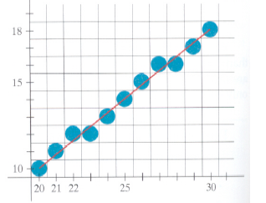
Example (cont.)

Slide 107
Bresenham’s Line Algorithm (cont.)
Notice that bresenham’s algorithm works on lines with slope in range 0 < m < 1.
We draw from left to right.
To draw lines with slope > 1, interchange the roles of x and y directions.

Slide 108
Circle Generating Algorithms
What is a circle?
It is a set of points that are all at a given distance r from center position (x_{c}, y_{c}).
The distance relationship equation of a circle is expressed by the Pythagorean theorem in Cartesian coordinates as:
( x – x_{c})² + ( y – y_{c})² = r²

Slide 109
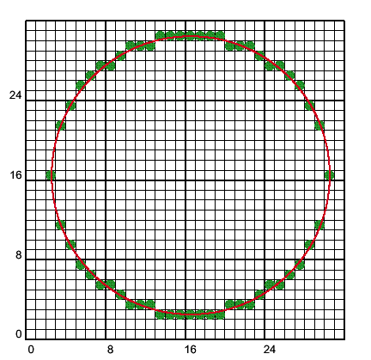
Circle Generating Algorithms (cont.)
We can re-write the circle equation as:
y = y_{c} ± ( r² – ( x – x_{c})² )^{0.5}
By substitution with x , x_{c} and y_{c} we can get y.
Two problems with this approach:
it involves considerable computation at each step.
The spacing between plotted pixel positions is not uniform, as demonstrated below

Slide 110
Circle Generating Algorithms (cont.)
Polar coordinates (r and θ) are used to eliminate the unequal spacing shown above.
Expressing the circle equation in parametric polar form yields the pair of equations
x = x_{c} + r cos θ
y = y_{c} + r sin θ

Slide 111
Circle Generating Algorithms (cont.)
When a circle is generated with these equations using a fixed angular step size, a circle is plotted with equally spaced points along the circumference.
The step size chosen θ depends on the application and the display device.
Computation can be reduced by considering the symmetry of circles. The shape of the circle is similar in each quadrant.
We can take this one step further and note that there is also symmetry between octants.

Slide 112
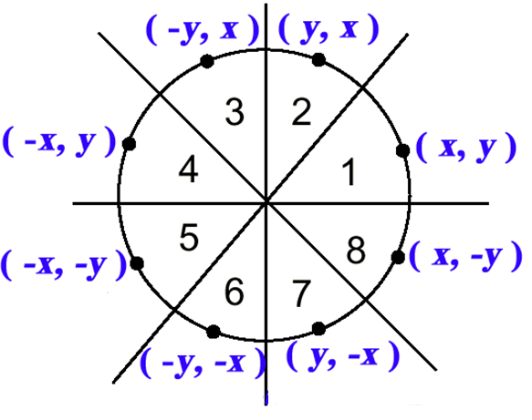
Circle Generating Algorithms (cont.)

Slide 113
Mid-point circle algorithm
A method for direct distance comparison is to test the halfway position between two pixels to determine if this midpoint is inside or outside the circle boundary.
This method is more easily applied to other conics, and for an integer circle radius.
we sample at unit intervals and determine the closest pixel position to the specified circle path at each step.

Slide 114
Mid-point circle algorithm (cont.)
For a given radius r and screen center position (x_{c}, y_{c}), we can first set up our algorithm to calculate pixel positions around a circle path centered at the coordinate origin ( 0, 0 ).
Then each calculated position (x, y) is moved to its proper screen position by adding x_{c} to x and y_{c} to y.
Along the circle section from x = 0 to x = y in the first quadrant, the slope of the curve varies from 0 to - 1.
Therefore, we can take unit steps in the positive x direction over this octant and use a decision parameter to determine which of the two possible y positions is closer to the circle path at each step.

Slide 115
Mid-point circle algorithm (cont.)
Positions in the other seven octants are then obtained by symmetry.
To apply the midpoint method. we define a circle function:
f_{circle}(x, y) = x² + y² – r²
Any point (x, y) on the boundary of the circle with radius r satisfies the equation f_{circle}( x, y ) = 0.
If f_{circle}( x, y ) < 0, the point is inside the circle boundary ,
If f_{circle}( x, y ) > 0, the point is outside the circle boundary,
If f_{circle}( x, y ) = 0, the point is on the circle boundary.

Slide 116
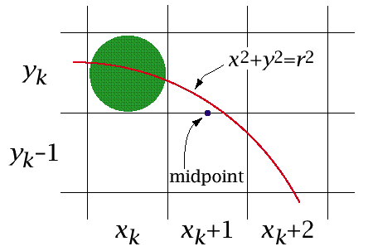
Mid-point circle algorithm (cont.)

Slide 117
Mid-point Circle Algorithm Calculating p_{k}
First, set the pixel at (xk , yk ), next determine whether the pixel (xk + 1, yk ) or the pixel (xk + 1, yk – 1) is closer to the circle using:
p_{k} = fcircle (xk + 1,yk – ½)= (xk + 1)²+(yk – ½)² – r²

Slide 118
Calculating P_{k +1}
P_{k +1} = fcircle (xk + 1 + 1,yk + 1 – ½)
=[(xk + 1) + 1 ]² + (yk + 1 – ½)² – r²
Or
Pk + 1 = pk + 2(xk + 1) + (y²k+ 1 – y²k ) – (yk+ 1 – yk ) + 1

Slide 119
Calculating p₀
p₀ = fcircle (1, r – ½) = 1 + (r – ½)² – r² or
p₀ = 5 /4 – r ≅ 1 – r

